Slide 1
Derivatives
Eric Prebys

Slide 2
Derivatives in Physics
Pretty much all of physics involves differentials
The definition of a differential is the limit of difference between dependent variable points over the difference between the independent variable, as that difference goes to zero
And by now you know how to find the derivatives of arbitrarily complicated explicit functions using the chain rule.

Slide 3
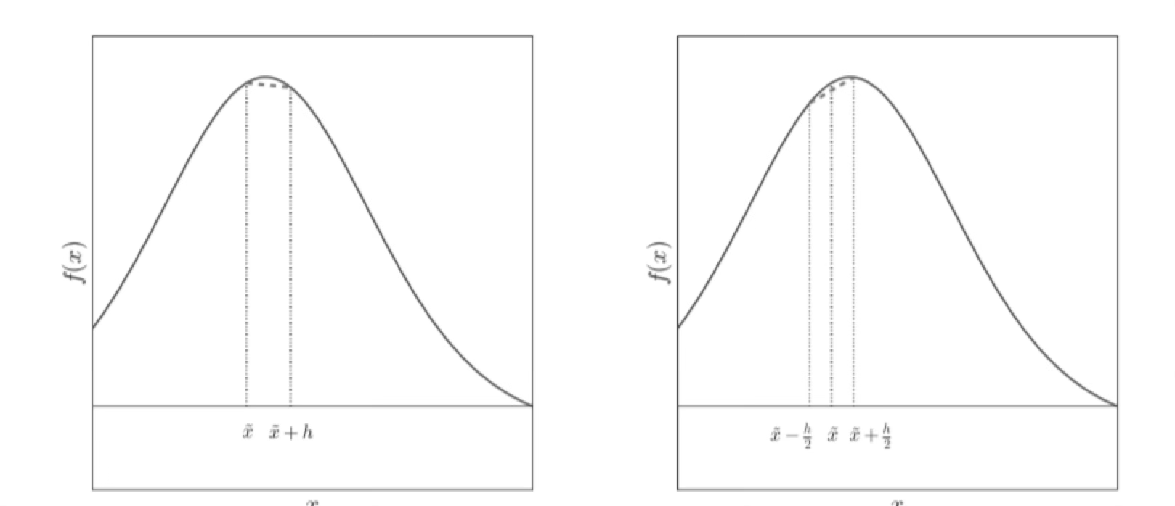
Numerical Differentiation
Sometimes functions are not explicit
  E.g. may be based on arbitrary distributions of real data.
In this case, we need to numerically differentiate.
We can’t take h to zero, so we need to figure out how accurate we are if we don’t.

Slide 4
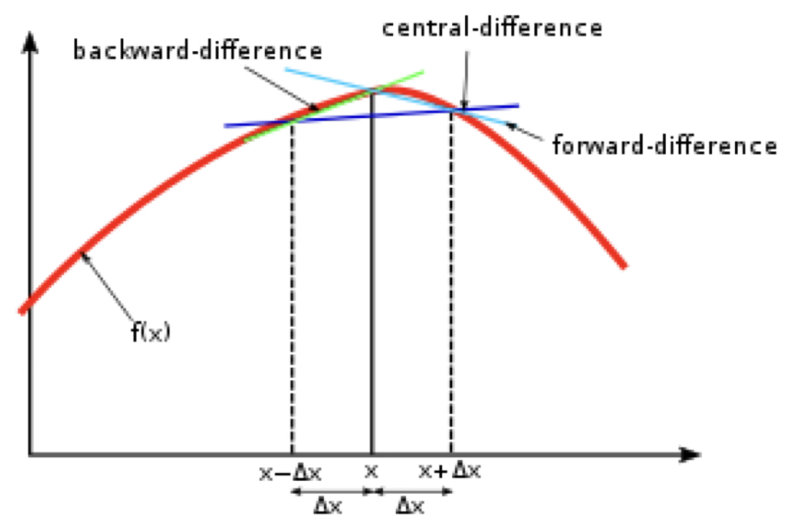
Different Ways of Looking at the Derivative
Forward Difference:
Backward Difference:
Central Difference:

Slide 5
Consider the first
Can’t really go to zero, so we have to consider the errors
  The smaller h is, the better our approximation is
  BUT, the smaller h is, the bigger our round-off error is.
Need to optimize!

Slide 6
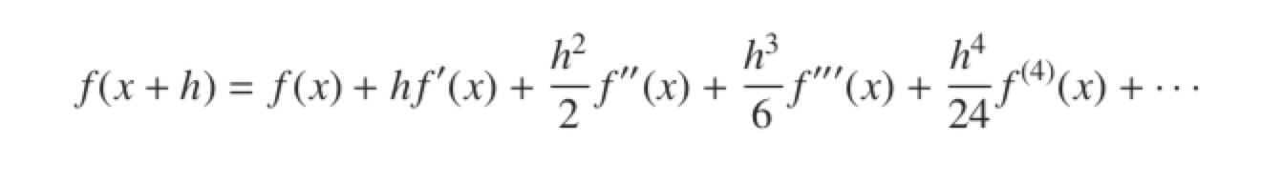
Approximation Error
Taylor expand
As h gets small, the first term will dominate, so the error of our approximation is approximately

Slide 7
Looking backward?
Again

Slide 8
Round-off Error
The round off error comes into play when f(x) and f(x+h) are very close.
So the total error is roughly
Gets bigger with h
Gets smaller with h

Slide 9
Errors
We can’t take our h to zero, so we need to choose and optimum value
There are two types of errors associated with our calculation
  The error associated with the Taylor approximation,
  which will get smaller as h gets smaller.
  The round-off error when taking the difference,
  which will get larger as h gets smaller.

Slide 10
Find the Minimum
Take the derivative wrt h

Slide 11
Central Difference Derivative

Slide 12
Minimizing the Error…
In this case
Compare to forward or backward only
Bigger step
Smaller error

Slide 13
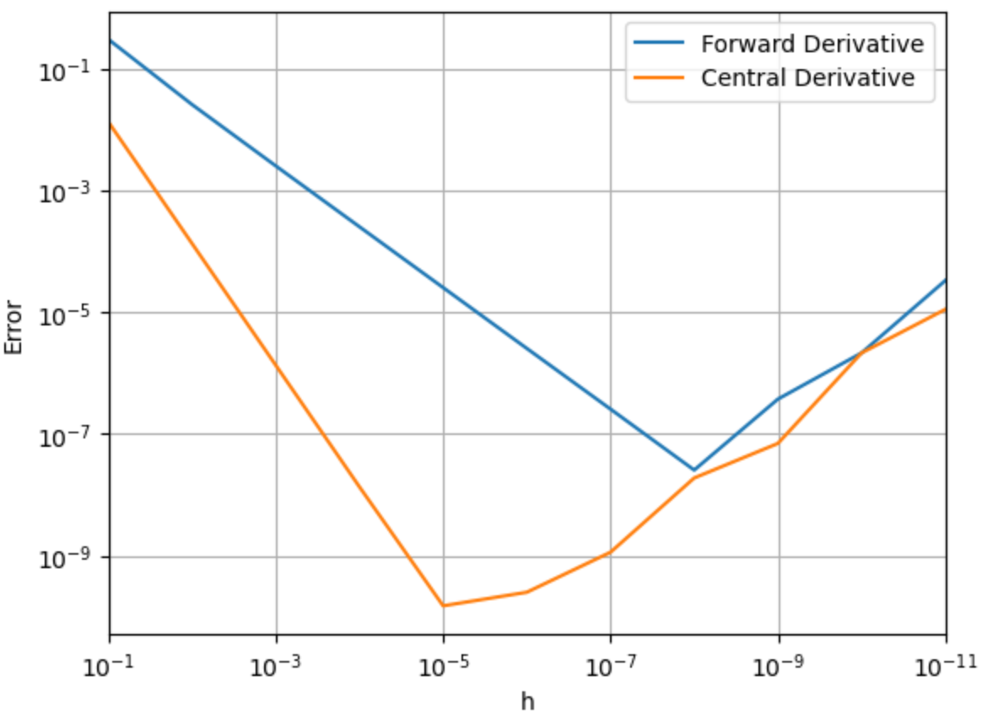
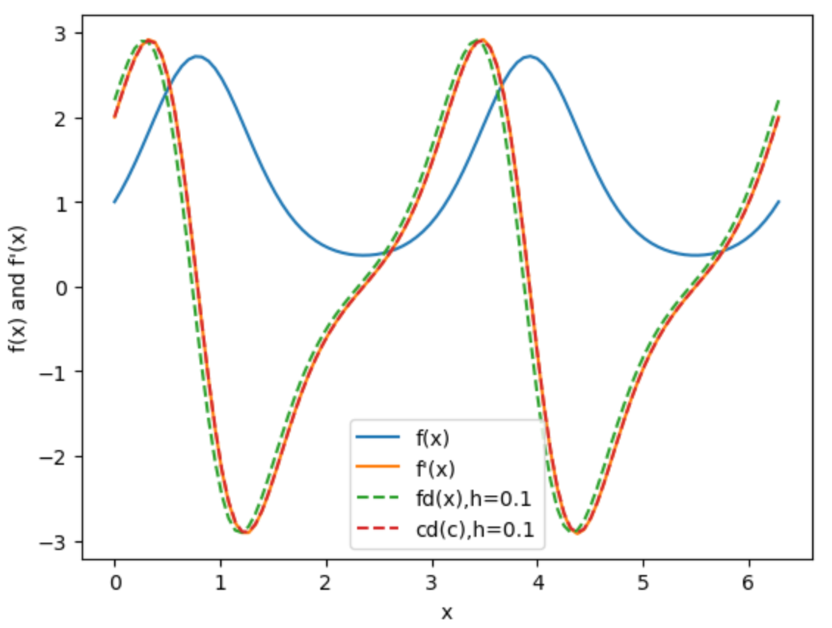
Test*
Compare errors for forward and central derivatives
Plot:
f(x)
f’(x)
Forward derivative (fd)
Central derivative (cd)
Central Derivative
Optimum step size 1000 time larger
Minimum error 100 times smaller
*see ‘Lecture 7 – Derivatives.ipynb’

Slide 14
Second Derivatives
We can derive second derivatives from first derivatives in the same way.

Slide 15
Digression: Laplace Equation
Many things, including:
  Static electric fields in the absence of charges
  Static magnetic fields in the absence of currents
  Temperature gradients
obey the Laplace equation, which is essentially a
conservation of flux
In three dimensions
In two dimensions

Slide 16
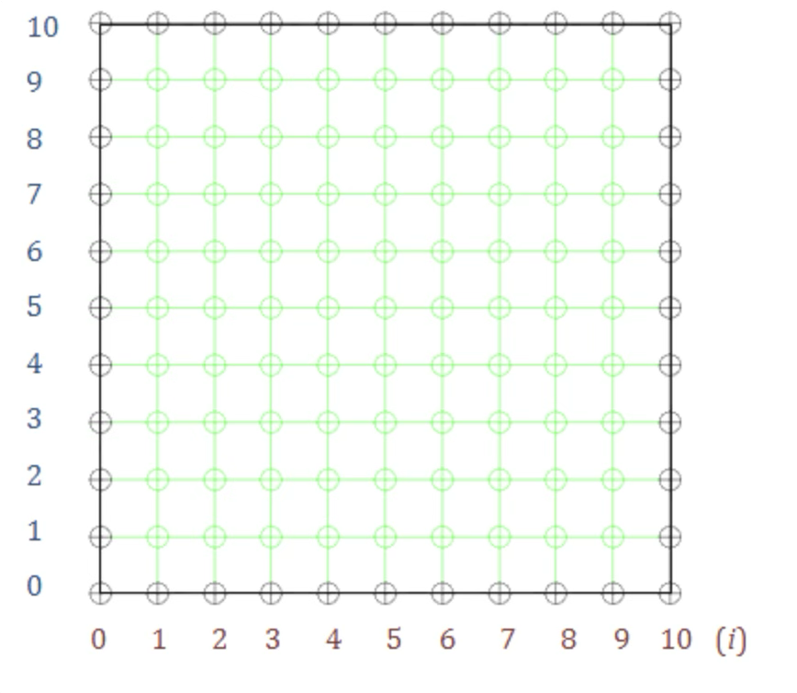
Example: 2-Dimensional Temperature Gradient
Temperatures on a uniformly conducting
plane will obey the 2D Laplace equation.

Slide 17
Solving this in practice…
Ttop
Set the boundary conditions on
the edges of the array
Make a guess about the
temperatures in the middle
Keep applying our interpolation
algorithm to the points in the plane
until they converge on a stable
equilibrium solution
  Example: first guess for lower right
  corner
Tleft
Tguess
Tright
Tbottom

Slide 18
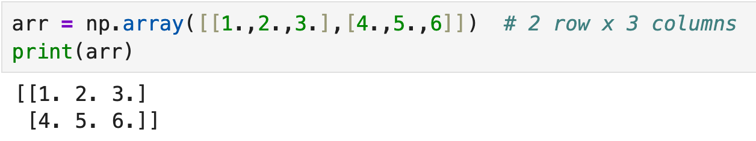
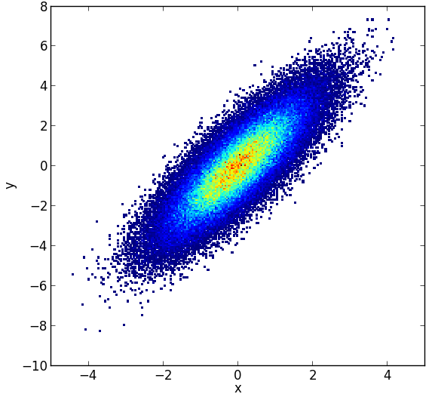
A Word About Plotting Arrays…
Python arrays are “row priority”. Example
When we plot an array, it will plot as
In other words, the first index
corresponds to y and the second
index corresponds to x
  Which is a bit counterintuitive
Row 0
Column 0

